Slide 1

50.039 Theory and Practice of Deep Learning W1-S3 Introduction and Machine Learning Reminders
Matthieu De Mari

Slide 2
About this week (Week 1)
What are the typical concepts of Machine Learning to be used as a starting point for this course?
What are the different families of problems in Deep Learning?
What is the typical structure of a Deep Learning problem?
What is linear regression and how to implement it?
What is the gradient descent algorithm and how is it used to train Machine Learning models?
What is polynomial regression and how to implement it?
What is regularization and how to implement it in Ridge regression?

Slide 3
About this week (Week 1)
What is overfitting and why is it bad?
What is underfitting and why is it bad?
What is generalization and how to evaluate it?
What is a train-test split and why is it related to generalization?
What is a sigmoid function? What is a logistic function?
How to perform binary classification using a logistic regressor and how is it related to linear regression?

Slide 4
About this week (Week 1)
What are Neural Networks and how do they relate to the biology of a human brain?
What is a Neuron in a Neural Network and how does it relate to linear/logistic regression?
What is the difference between a shallow and a deep neural network?
How to implement a shallow Neural Network manually and define a forward propagation method for it?
(How to train a shallow Neural Network using backpropagation? How to define backward propagation and trainer functions?)

Slide 5
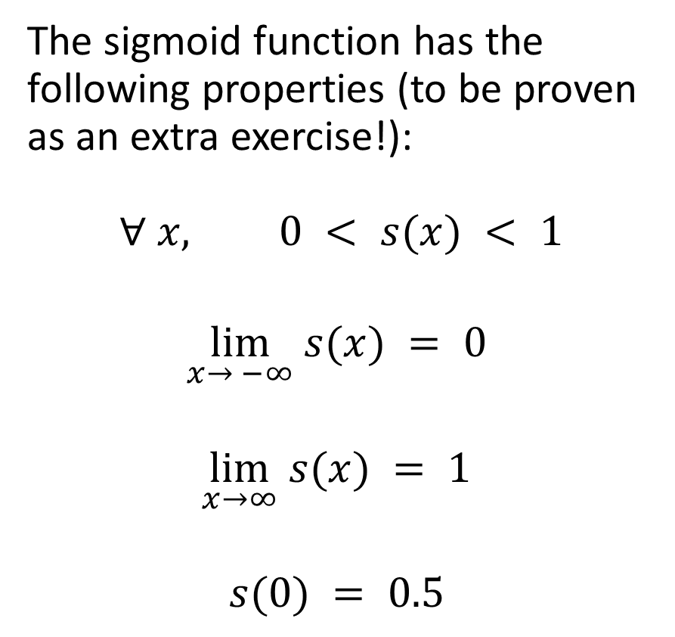
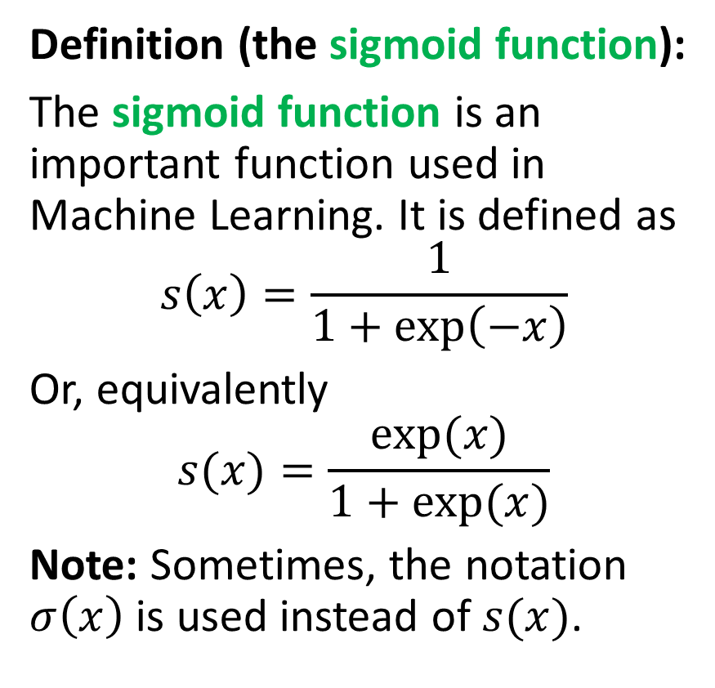
Introducing the sigmoid function
Definition (the sigmoid function):
The sigmoid function is an important function used in Machine Learning. It is defined as
$$s\left(x\right)=\frac{1}{1+\exp\left(−x\right)}$$
Or, equivalently
$$s(x)=\frac{exp⁡(x)}{1+exp⁡(x)}$$
Note: Sometimes, the notation $σ\left(x\right)$ is used instead of $s(x)$.
The sigmoid function has the following properties (to be proven as an extra exercise!):
$$∀ x, 0 < s(x) < 1$$
$$\lim_{x→ −∞} s(x) = 0$$
$$\lim_{x→∞} s(x) = 1$$
$$s(0) = 0.5$$

Slide 6
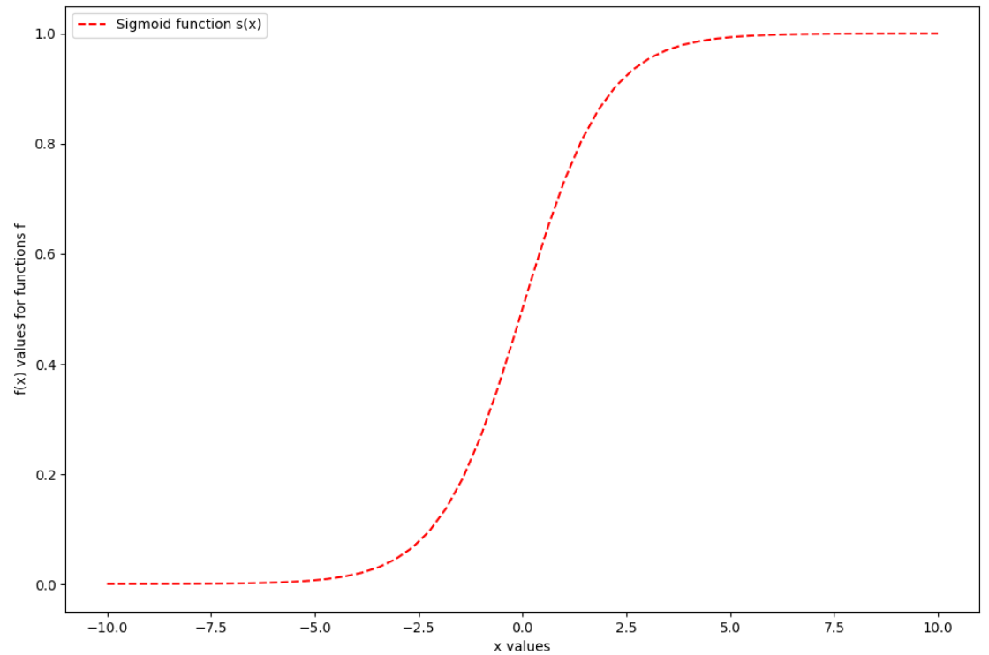


Introducing the sigmoid function
Definition (the sigmoid function):
The sigmoid function is an important function used in Machne Learning. It is defined as
$$s\left(x\right)=\frac{1}{1+\exp\left(−x\right)}$$
Or, equivalently
$$s(x)=\frac{exp⁡(x)}{1+exp⁡(x)}$$
The sigmoid function has the following properties:
$$∀ x, 0 < s(x) < 1$$
$$\lim_{x→ −∞} s(x) = 0$$
$$\lim_{x→∞} s(x) = 1$$
$$s(0) = 0.5$$

Slide 7
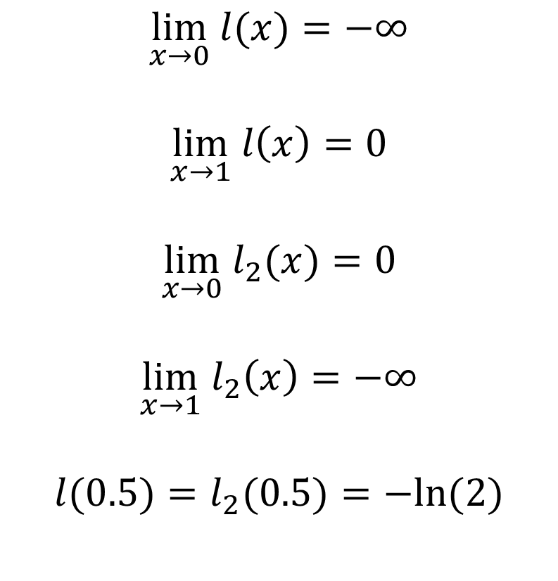
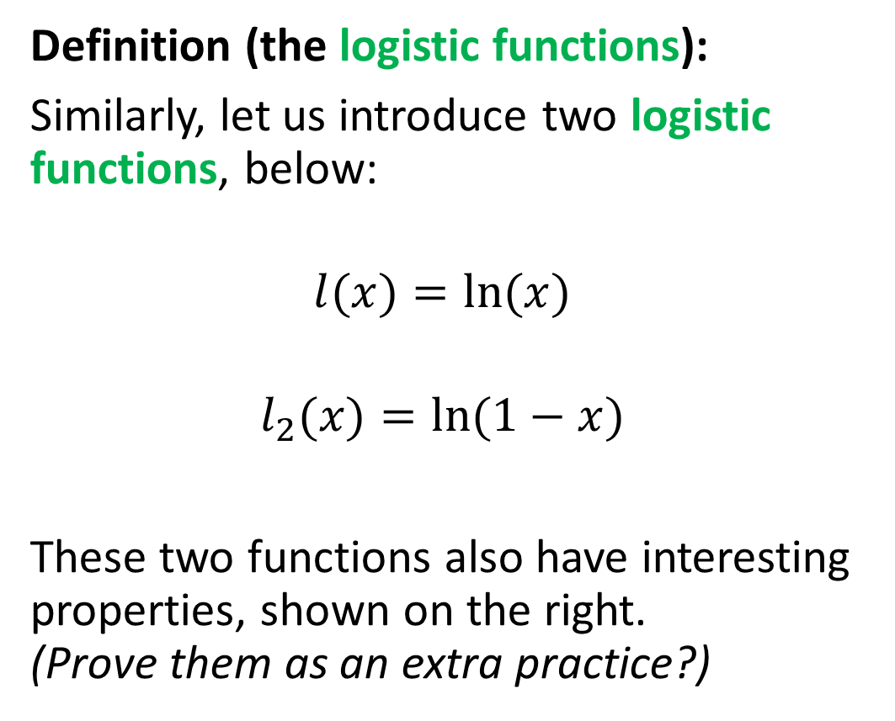
Also introducing two logistic functions
Definition (the logistic functions):
Similarly, let us introduce two logistic functions, below:
$$l(x)=ln⁡(x)$$
$$l_{2}(x)=ln⁡(1−x)$$
These two functions also have interesting properties, shown on the right. (Prove them as an extra practice?)
$$\lim_{x→0} l(x)=−∞$$
$$\lim_{x→1} l\left(x\right)=0$$
$$\lim_{x→0} l_{2}(x)=0$$
$$\lim_{x→1}{ l}_{2}\left(x\right)=−∞$$
$$l(0.5)=l_{2}(0.5)=−ln⁡(2)$$

Slide 8
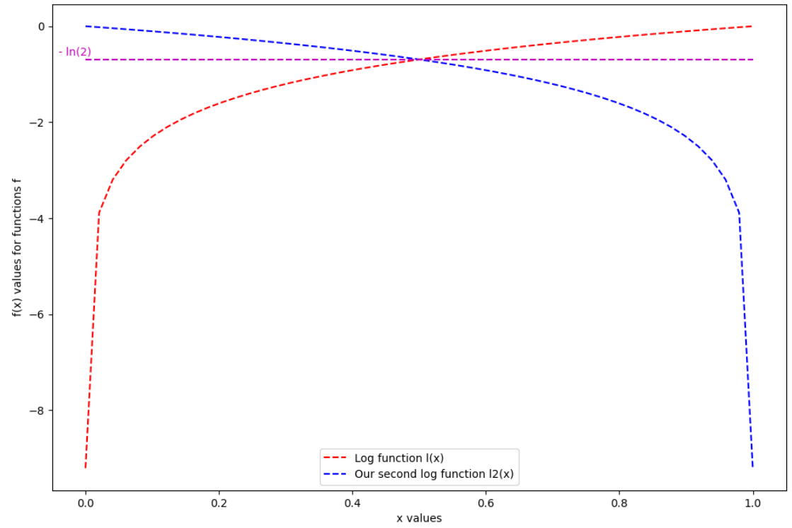


Introducing two logistic functions
Definition (the logistic functions):
Similarly, let us introduce two logistic functions, below:
$$l(x)=ln⁡(x)$$
$$l_{2}(x)=ln⁡(1−x)$$
These two functions also have interesting properties.
$$\lim_{x→0} l(x)=−∞$$
$$\lim_{x→1} l\left(x\right)=0$$
$$\lim_{x→0} l_{2}(x)=0$$
$$\lim_{x→1}{ l}_{2}\left(x\right)=−∞$$
$$l(0.5)=l_{2}(0.5)=−ln⁡(2)$$

Slide 9
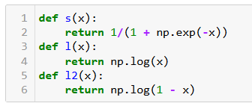
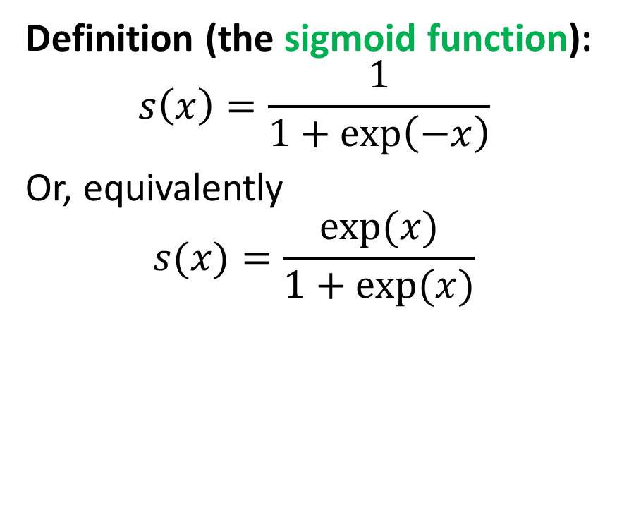
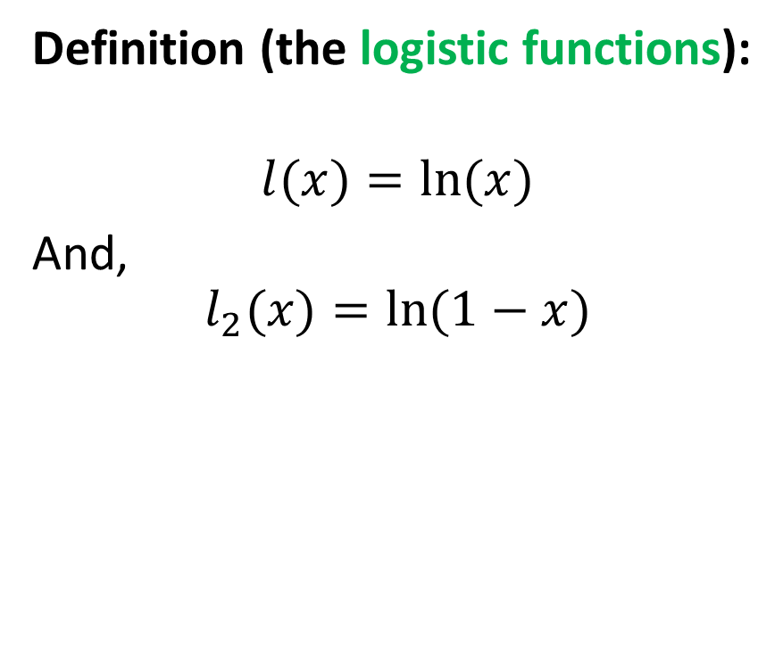
To recap: functions and implementations
Definition (the sigmoid function):
$$s\left(x\right)=\frac{1}{1+\exp\left(−x\right)}$$
Or, equivalently
$$s(x)=\frac{exp⁡(x)}{1+exp⁡(x)}$$
Definition (the logistic functions):
$$l(x)=ln⁡(x)$$
And,
$$l_{2}(x)=ln⁡(1−x)$$

Slide 10
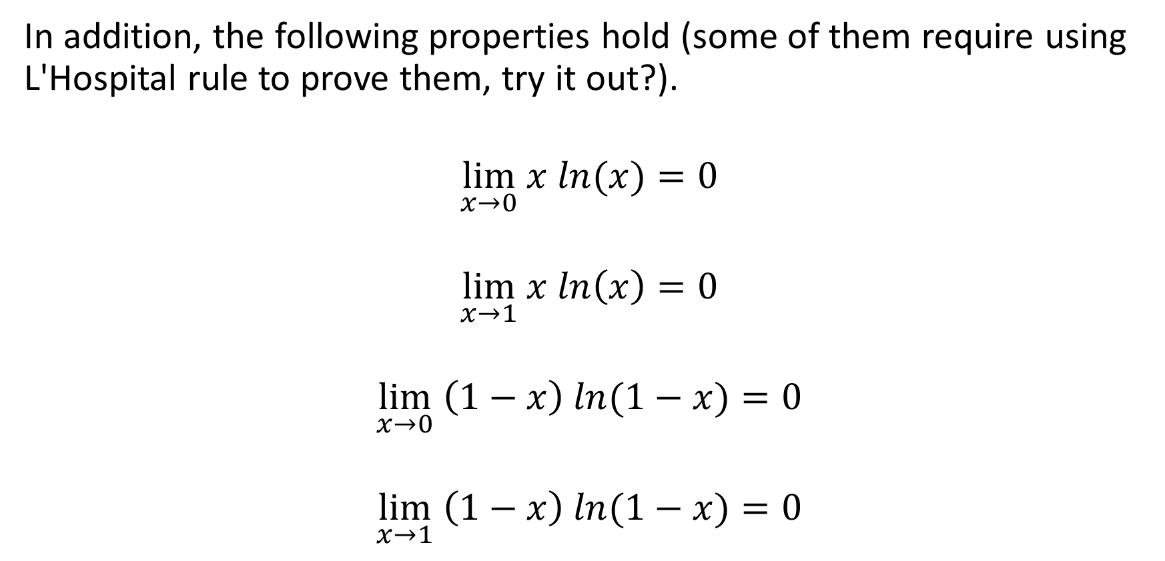
Results on mixes for our two logistic functions
In addition, the following properties hold (some of them require using L'Hospital rule to prove them, try it out?).
$$\lim_{x→0} x ln(x)=0$$
$$\lim_{x→1} x ln\left(x\right)=0$$
$$\lim_{x→0} \left(1−x\right) ln⁡(1−x)=0$$
$$\lim_{x→1} \left(1−x\right) ln⁡(1−x)=0$$

Slide 11
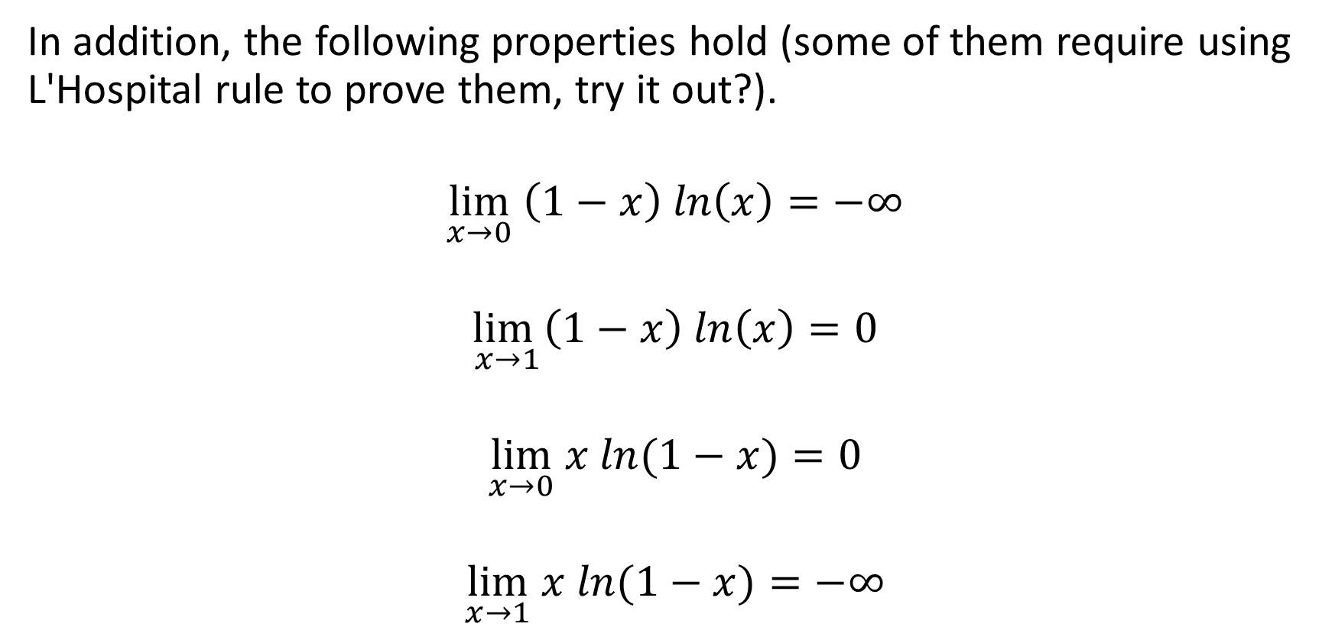
Results on mixes for our two logistic functions
In addition, the following properties hold (some of them require using L'Hospital rule to prove them, try it out?).
$$\lim_{x→0} \left(1−x\right) ln\left(x\right)=−∞$$
$$\lim_{x→1}\left(1−x\right) ln\left(x\right)=0$$
$$\lim_{x→0} x ln⁡(1−x)=0$$
$$\lim_{x→1} x ln⁡(1−x)=−∞$$

Slide 12
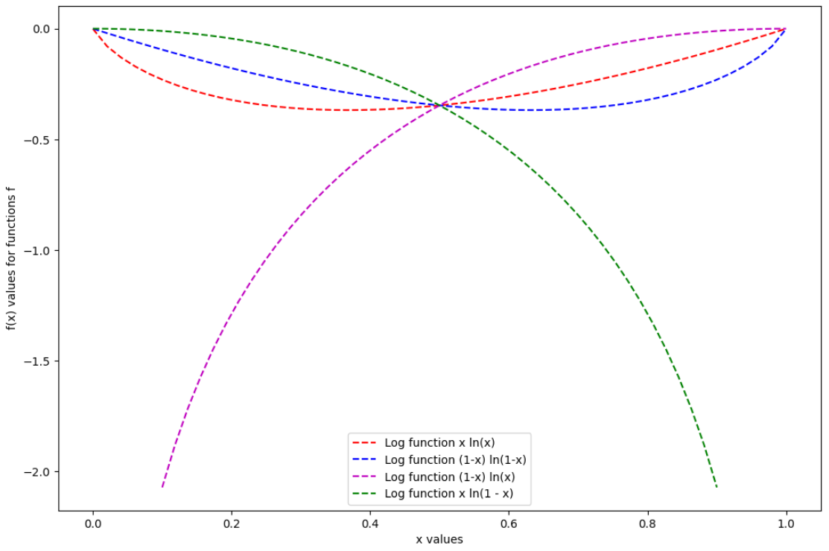

Introducing two logistic functions
In addition, the following properties hold (some of them require using L'Hospital rule to prove them).
$$\lim_{x→0} \left(1−x\right) ln\left(x\right)=−∞$$
$$\lim_{x→1}\left(1−x\right) ln\left(x\right)=0$$
$$\lim_{x→0} x ln⁡(1−x)=0$$
$$\lim_{x→1} x ln⁡(1−x)=−∞$$

Slide 13
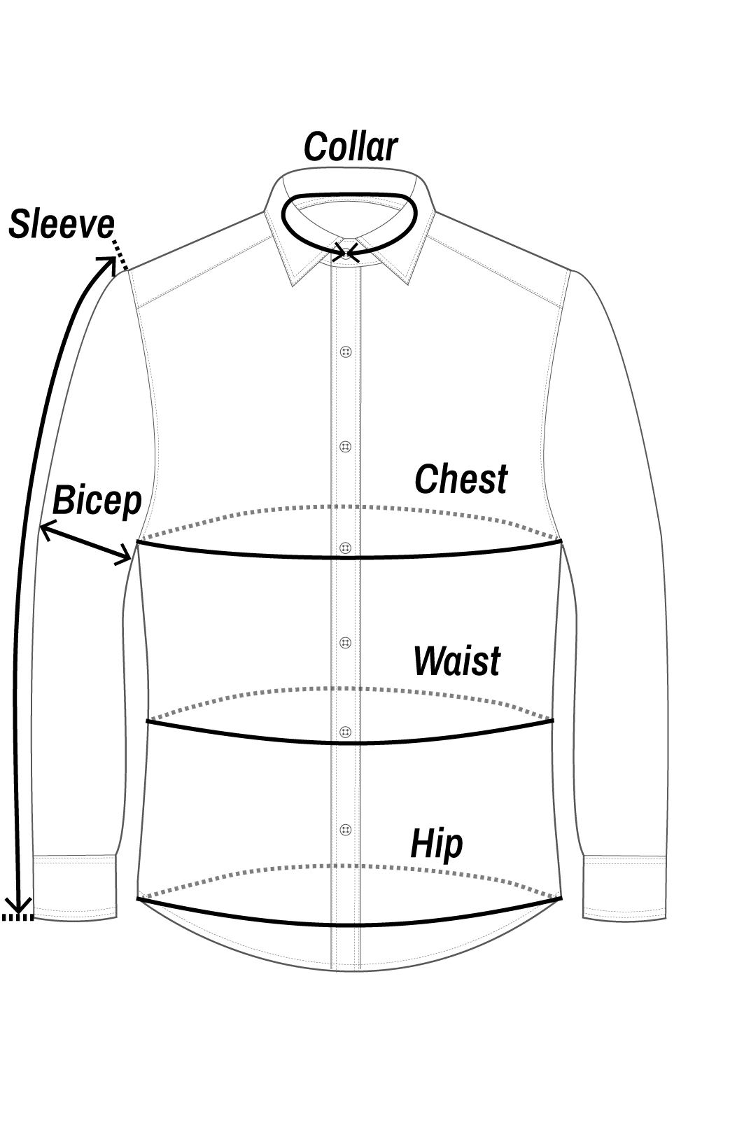
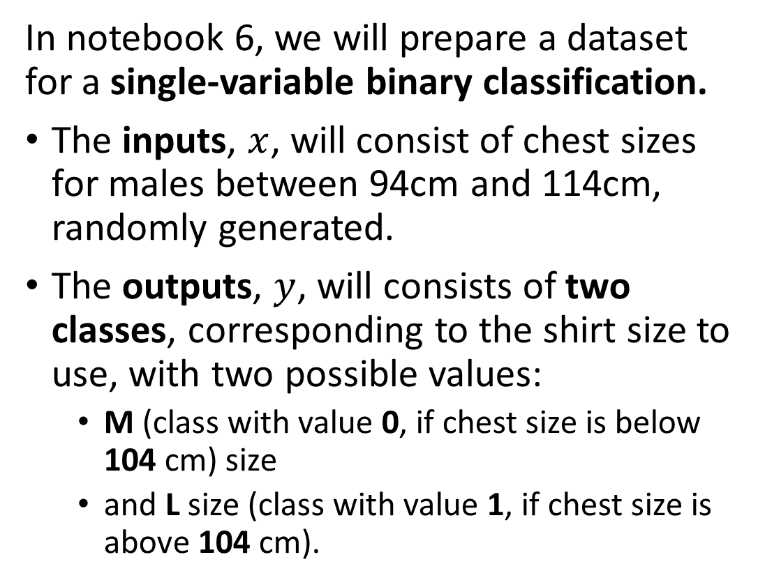
New mock dataset generation
In notebook 6, we will prepare a dataset for a single-variable binary classification.
The inputs, $x$, will consist of chest sizes for males between 94cm and 114cm, randomly generated.
The outputs, $y$, will consists of two classes, corresponding to the shirt size to use, with two possible values:
M (class with value 0, if chest size is below 104 cm) size
and L size (class with value 1, if chest size is above 104 cm).

Slide 14
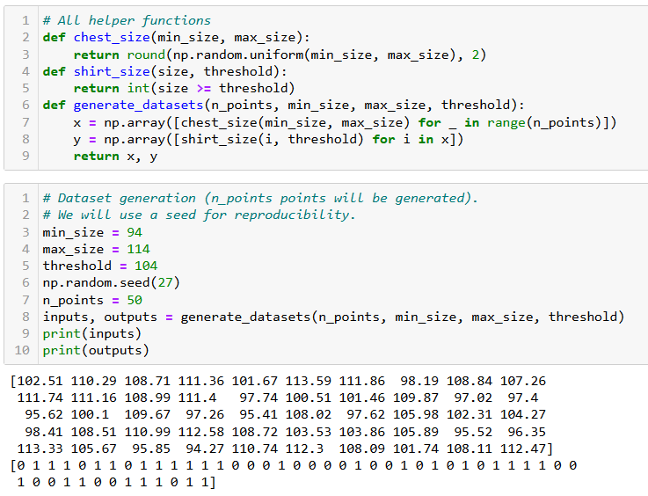

Slide 15
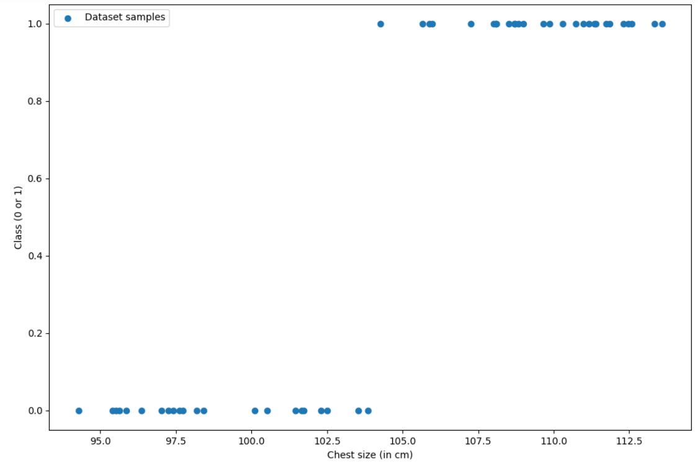

Slide 16
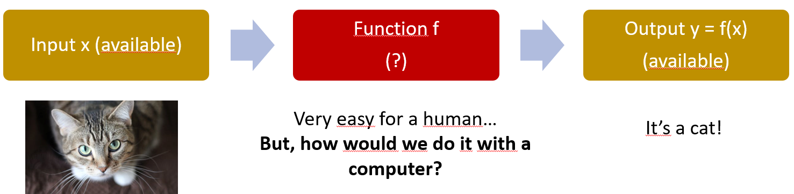
A quick word about expert systems
Definition (expert systems):
An expert system is a computer program that mimics the decision-making abilities of a human expert in a specific domain or field.
It uses knowledge represented in a symbolic form, such as rules or ontologies, to make inferences and decisions based on the data it receives.
Expert systems are “the dream” and provide a high level of performance and accuracy in solving problems or making decisions. But these are difficult to design as they require a strong, and not necessarily obvious, human expertise.

Slide 17
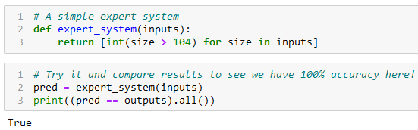
A quick word about expert systems
Definition (expert systems):
An expert system is a computer program that mimics the decision-making abilities of a human expert in a specific domain or field.
It uses knowledge represented in a symbolic form, such as rules or ontologies, to make inferences and decisions based on the data it receives.
Important note: in our case, we could define an expert system as shown below, but most of the time the datasets will not have a clear logic and you will have to rely on ML algorithms instead, basically “hoping the AI will figure out a logic that works”.

Slide 18
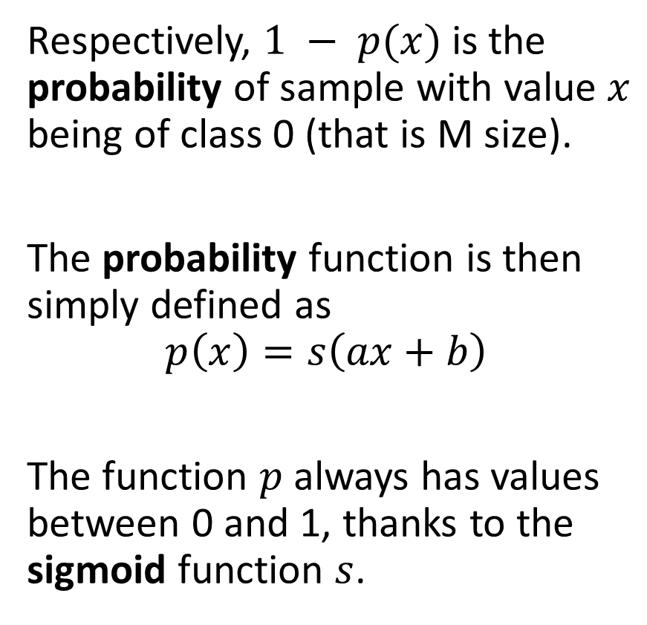
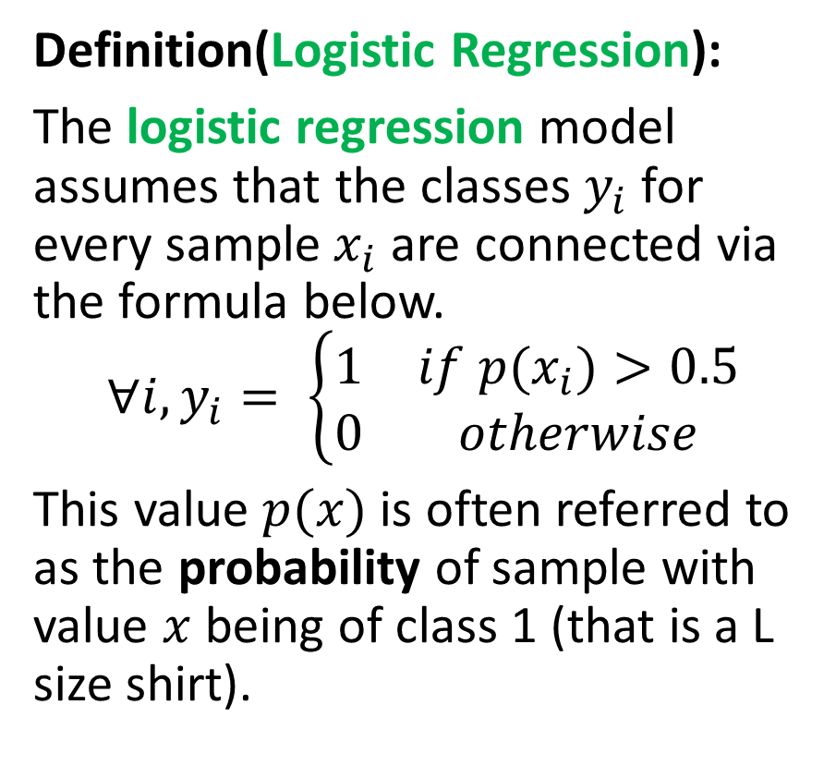
From Linear Regression to Logistic Regression
Definition(Logistic Regression):
The logistic regression model assumes that the classes $y_{i}$ for every sample$x_{i}$are connected via the formula below.
$$∀i, y_{i}= \left\{\begin{matrix}1 & if p(x_{i})>0.5 \\ 0 & otherwise\end{matrix}\right.$$
This value $p(x)$is often referred to as the probability of sample with value $x$ being of class 1 (that is a L size shirt).
Respectively, $1 − p(x)$is the probability of sample with value $x$ being of class 0 (that is M size).
The probability function is then simply defined as
$$p\left(x\right)=s\left(ax+b\right)$$
The function $p$always has values between 0 and 1, thanks to the sigmoid function $s$.

Slide 19
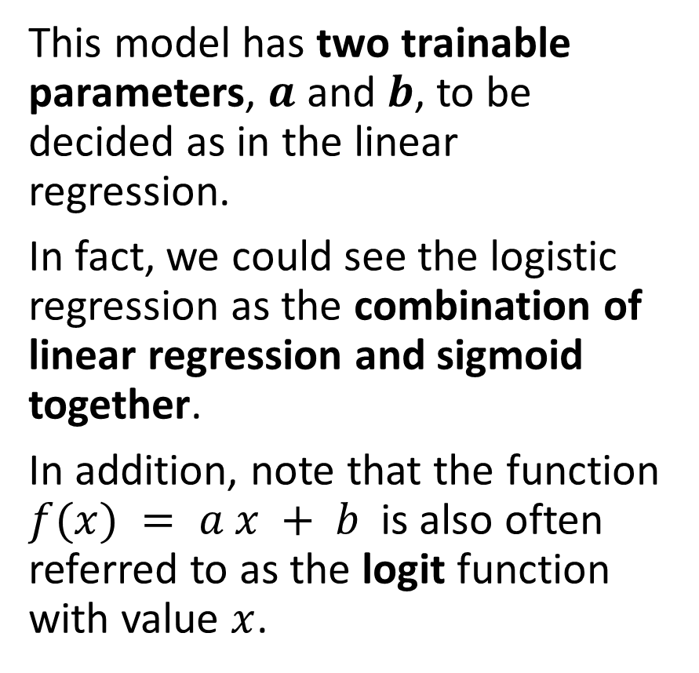
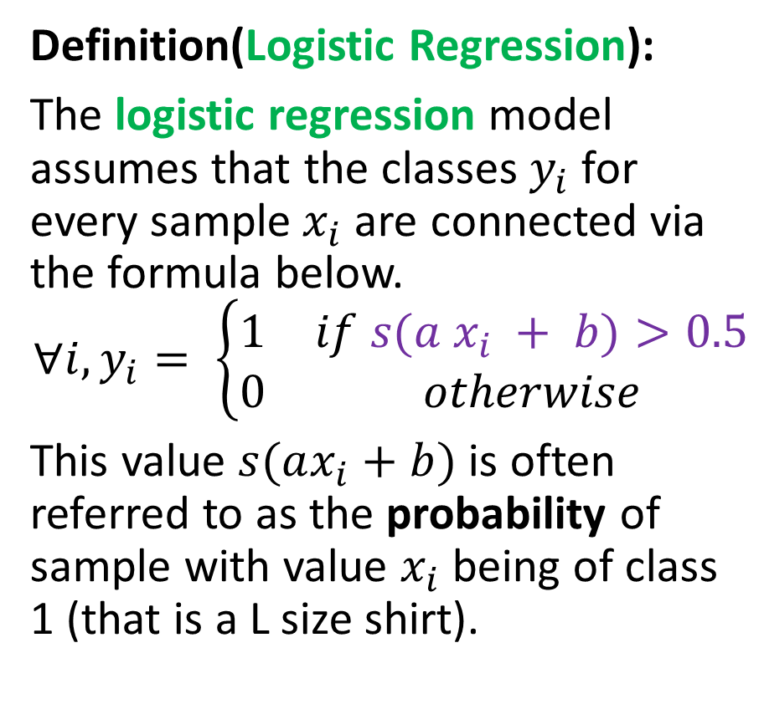
An adjusted Logistic Regression
Definition(Logistic Regression):
The logistic regression model assumes that the classes $y_{i}$ for every sample$x_{i}$are connected via the formula below.
$$∀i, y_{i}= \left\{\begin{matrix}1 & if s(a x_{i} + b)>0.5 \\ 0 & otherwise\end{matrix}\right.$$
This value $s(ax_{i}+b)$is often referred to as the probability of sample with value $x_{i}$ being of class 1 (that is a L size shirt).
This model has two trainable parameters, $a$ and $b$, to be decided as in the linear regression.
In fact, we could see the logistic regression as the combination of linear regression and sigmoid together.
In addition, note that the function $f(x) = a x + b$is also often referred to as the logit function with value $x$.

Slide 20
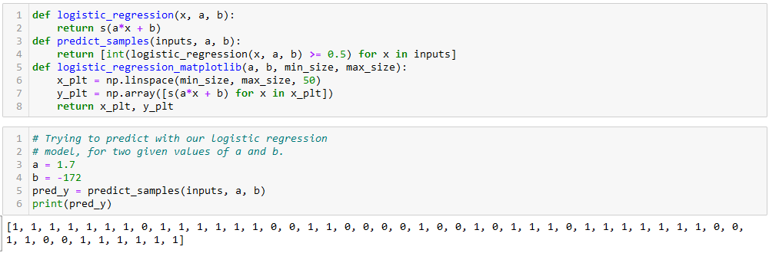

From Linear Regression to Logistic Regression
We can implement the logistic regression below and try it out with some values $a$ and $b$!

Slide 21
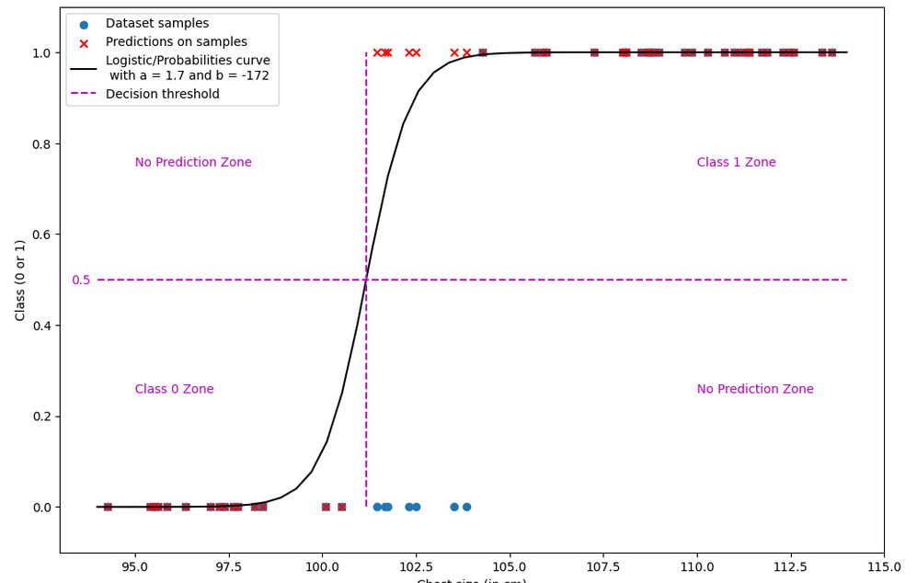

Slide 22
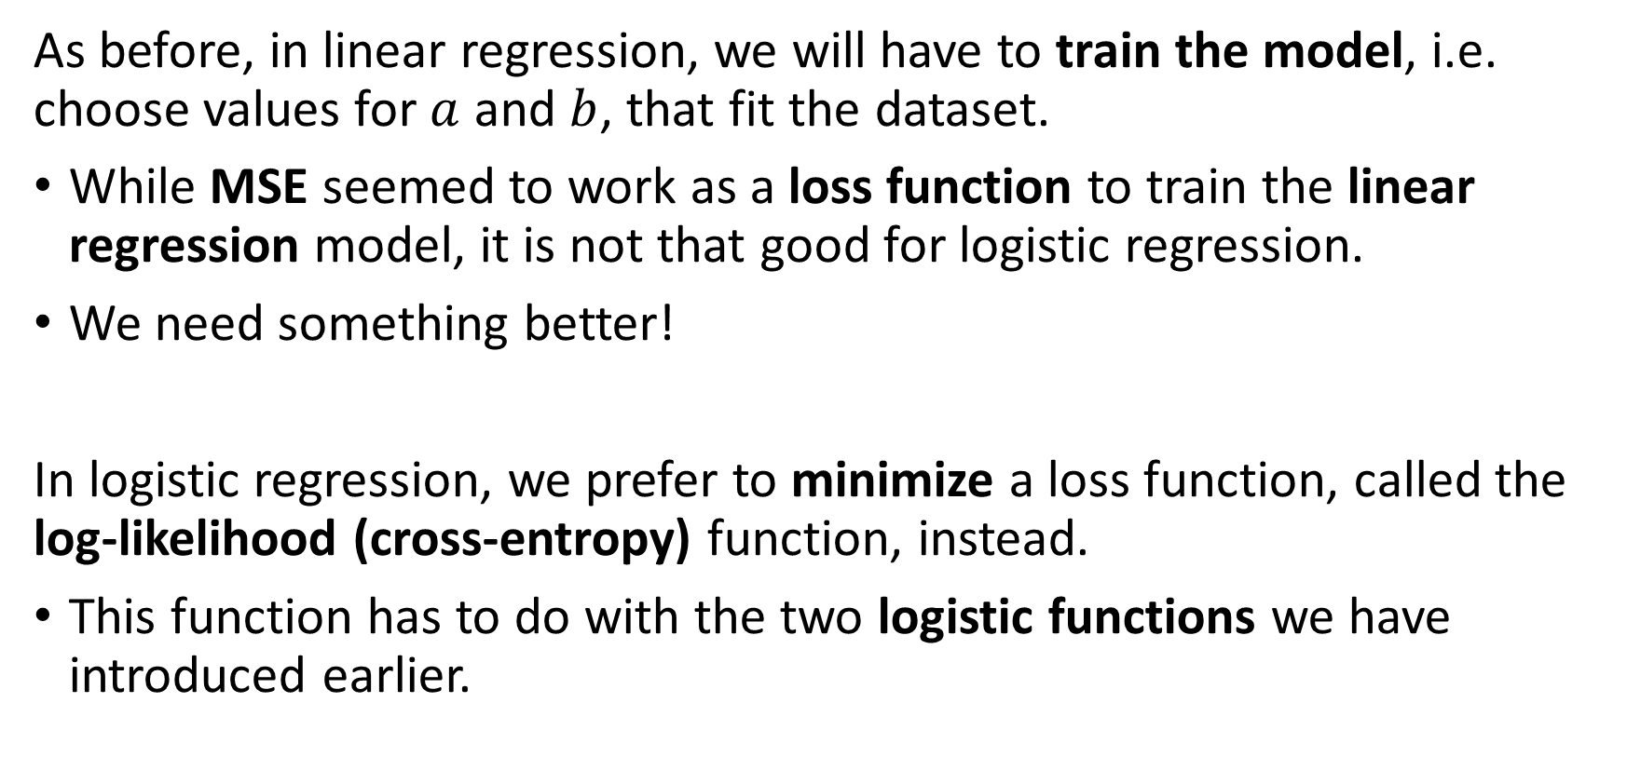
Training a logistic regressor
As before, in linear regression, we will have to train the model, i.e. choose values for $a$ and $b$, that fit the dataset.
While MSE seemed to work as a loss function to train the linear regression model, it is not that good for logistic regression.
We need something better!
In logistic regression, we prefer to minimize a loss function, called the log-likelihood (cross-entropy) function, instead.
This function has to do with the two logistic functions we have introduced earlier.

Slide 23
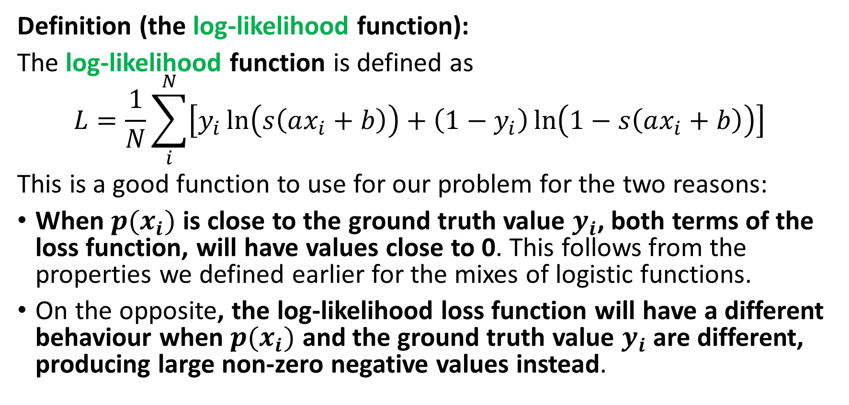
The log-likelihood function and loss
Definition (the log-likelihood function):
The log-likelihood function is defined as
$$L=\frac{1}{N}\sum_{i}^{N}{\left[y_{i}\ln\left(s\left(ax_{i}+b\right)\right)+\left(1−y_{i}\right)\ln\left(1−s\left(ax_{i}+b\right)\right)\right] }$$
This is a good function to use for our problem for the two reasons:
When $p(x_{i})$ is close to the ground truth value $y_{i}$, both terms of the loss function, will have values close to 0. This follows from the properties we defined earlier for the mixes of logistic functions.
On the opposite, the log-likelihood loss function will have a different behaviour when $p(x_{i})$ and the ground truth value $y_{i}$ are different, producing large non-zero negative values instead.

Slide 24
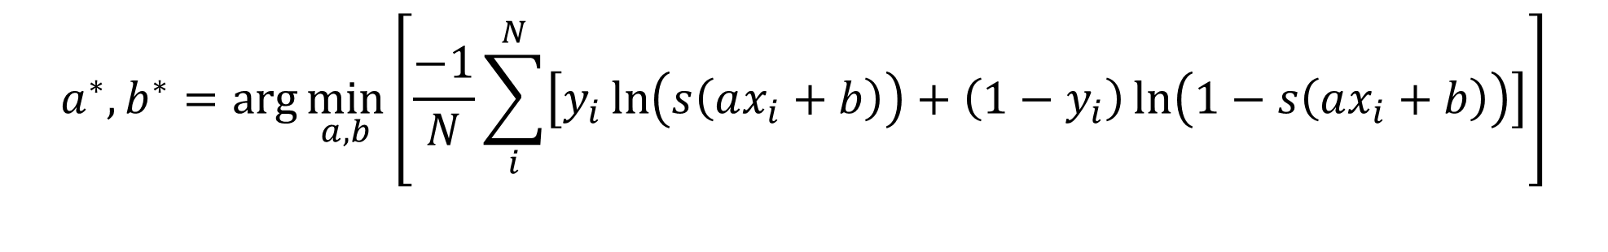
The log-likelihood function and loss
Definition (using the log-likelihood function as a loss):
This log-likelihood loss function is therefore a good choice of a performance/loss metric to measure the performance of our models.
Indeed, maximizing this log-likelihood loss function and bringing it to zero would be equivalent to finding the best choice of parameters 𝑎 and 𝑏, and therefore the best fit.
In practice however, we prefer to minimize loss functions. This requires a simple adjustment, multiplying the log-likelihood loss function by -1.
$$a^{∗},b^{∗}=\arg{\min_{a,b}\left[\frac{−1}{N}\sum_{i}^{N}{\left[y_{i}\ln\left(s\left(ax_{i}+b\right)\right)+\left(1−y_{i}\right)\ln\left(1−s\left(ax_{i}+b\right)\right)\right]}\right]}$$

Slide 25

Implementing the log-likelihood loss
We can simply implement the log likelihood loss as shown below.
Note: We could look for the ”normal equation” for the logistic regression, but this simply will not work. It is simply impossible to solve the logistic regression problem analytically.
(Not convinced? Try solving it analytically!).

Slide 26
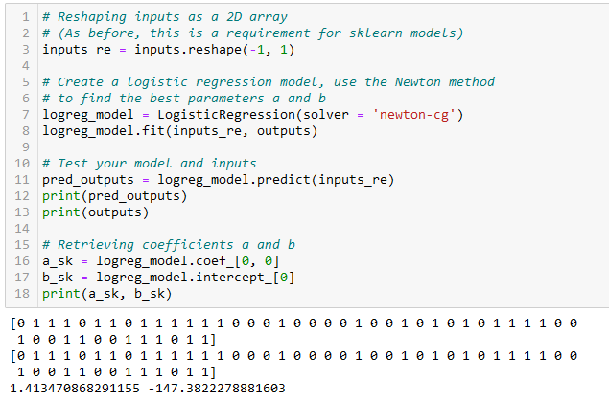
Training a logistic regressor
Instead, it is often preferable to rely on the gradient descent method, or the Newton method.
Typically, this is what the LogisticRegression() object in sklearn uses for training!
(Newton method is not covered but feel free to look it up/try it out?)

Slide 27
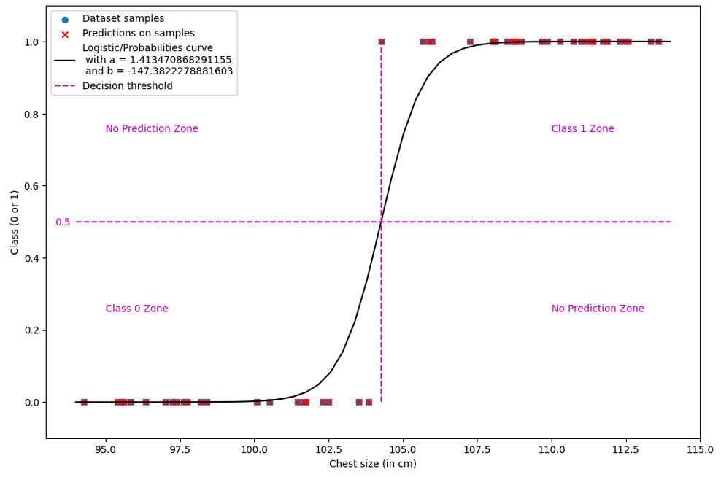

Slide 28
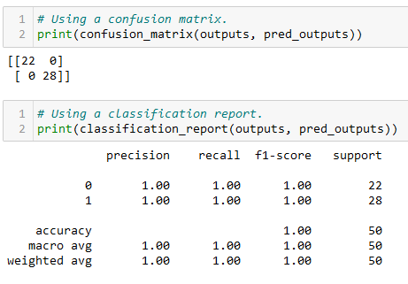
Evaluating the logistic regression model
When attempting to evaluate a classification model, it is often a good idea to first display a confusion matrix for the predicted values of the dataset samples (test samples, preferably).
We can simply calculate it by using the confusion_matrix() function from sklearn. The non-diagonal elements have zero values, which is the sign that our model classifies perfectly.
Learn more, here: https://scikit-learn.org/stable/modules/generated/sklearn.metrics.confusion_matrix.html.

Slide 29
Evaluating the logistic regression model
We can also ask for a classification report for the trained model.
This shows the precision, recall and F1 scores for each class, as well as the overall accuracy of the model.
For each one of these interesting metrics, the best value is 1.0. Our model achieves a 1.0 score, suggesting that the model classifies perfectly.
Learn more, here: https://scikit-learn.org/stable/modules/generated/sklearn.metrics.classification_report.html#sklearn.metrics.classification_report.
Note: the details of these metrics and what they represented is not discussed here (covered in previous ML classes).

Slide 30
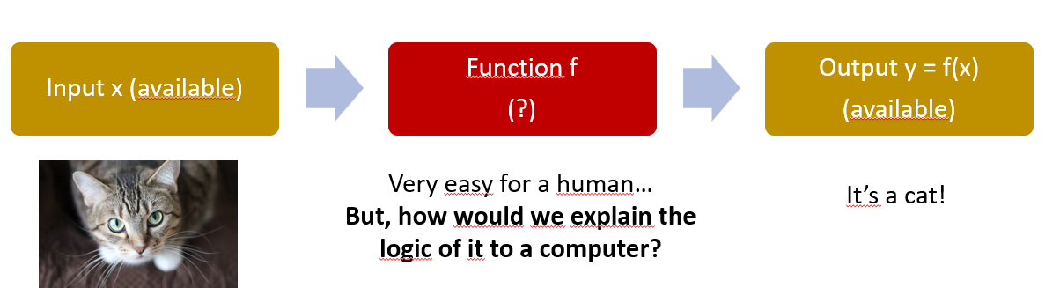
A bit of biology
Many tasks we have seen earlier (e.g. appt prices) are “difficult” to solve, or do not have an obvious “explainable” logic.
Our brain, however, seems very capable to solve these tasks.
Million dollar question: Could we replace the linear/polynomial/logistic models with a model that mimics the brain?

Slide 31
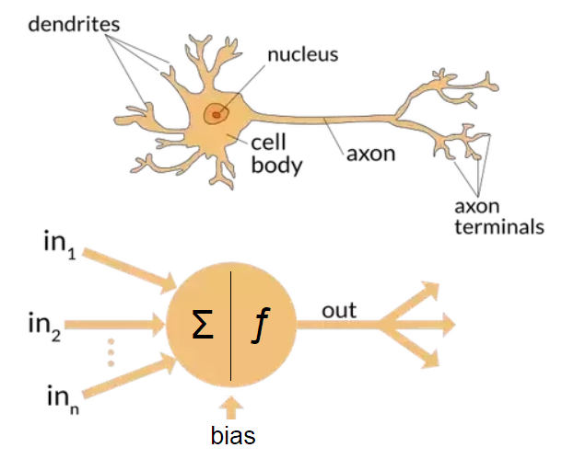
A bit of biology
Question: In neural networks, we will implement neurons, but are they really close to the ones in the human brain?
Neural networks are inspired by the neural structure and processes of the human brain.
Neural networks are comprised of interconnected nodes, which are called artificial neurons or perceptrons.
Neural networks are related to biology in that they are modelled after biological neural systems.

Slide 32
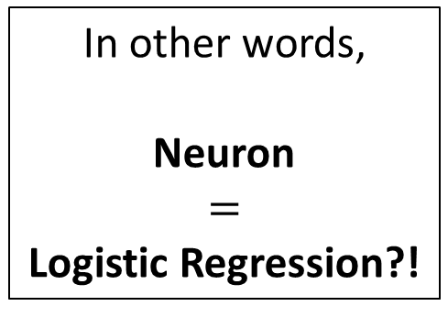
A bit of biology
In general,
A neuron will receive stimuli through its dendrites, in the form of electrical signals playing the role of inputs,
It will process the inputs in a certain way in its nucleus (and other parts of the neuron),
If the integrated signals reach a threshold, the neuron generates an action potential, a brief electrical impulse. This is an output coming from the axon terminal, in the form of a signal (1) or no signal (0) being produced.
In other words,
Neuron
$$=$$
Logistic Regression?!

Slide 33
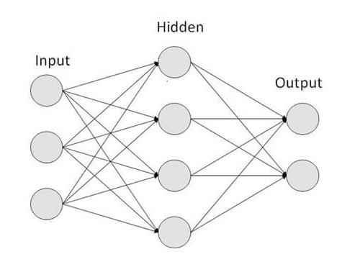
A bit of biology
But a human brain is not just one neuron, it is many of them arranged into a network of some sort!
Eventually, the output signal produced by a neuron will be passed to other neurons in the brain.
In fact, the brain could be seen as a set of several neurons processing information, both in parallel and in sequence.
This assembly, which resembles the human brain, is commonly referred to as a neural network.

Slide 34
A bit of biology
Research has shown that artificial neural networks (NN) could be used to solve some of the problems that biological NN can solve.
For example, neural networks can be used to identify objects in images, just as biological neural networks can.
The training process of CS neural networks is apparently very similar to the biological neural networks.
This is actually an ongoing argument/debate in the community [Quanta2021] and [MITNews2022].

Slide 35
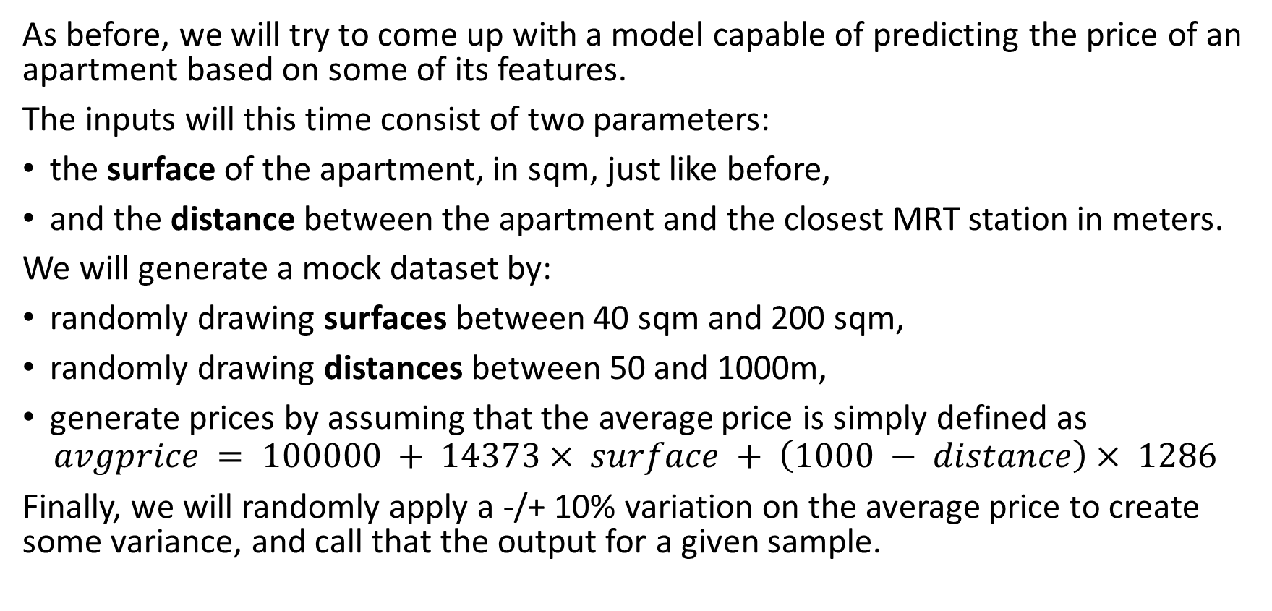
Starting with a mock dataset, again
As before, we will try to come up with a model capable of predicting the price of an apartment based on some of its features.
The inputs will this time consist of two parameters:
the surface of the apartment, in sqm, just like before,
and the distance between the apartment and the closest MRT station in meters.
We will generate a mock dataset by:
randomly drawing surfaces between 40 sqm and 200 sqm,
randomly drawing distances between 50 and 1000m,
generate prices by assuming that the average price is simply defined as
$$avgprice = 100000 + 14373× surface + \left(1000 − distance\right)× 1286$$
Finally, we will randomly apply a -/+ 10% variation on the average price to create some variance, and call that the output for a given sample.

Slide 36
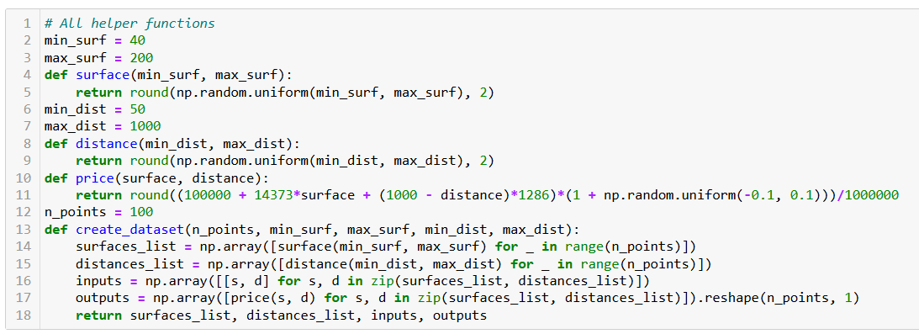
Starting with a mock dataset, again

Slide 37
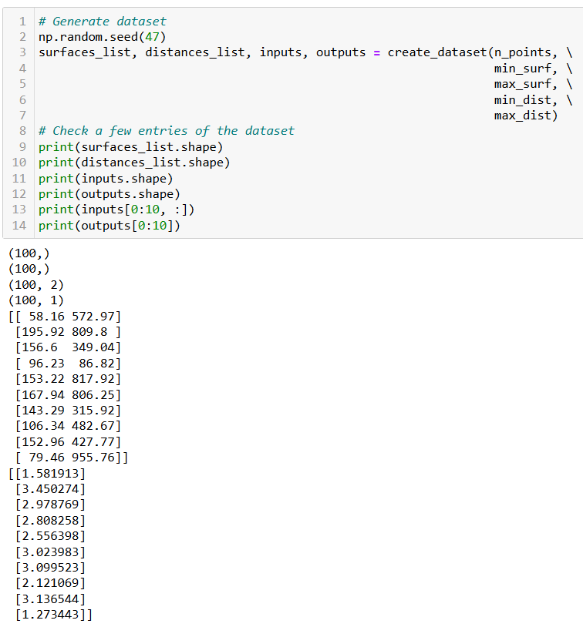

Slide 38
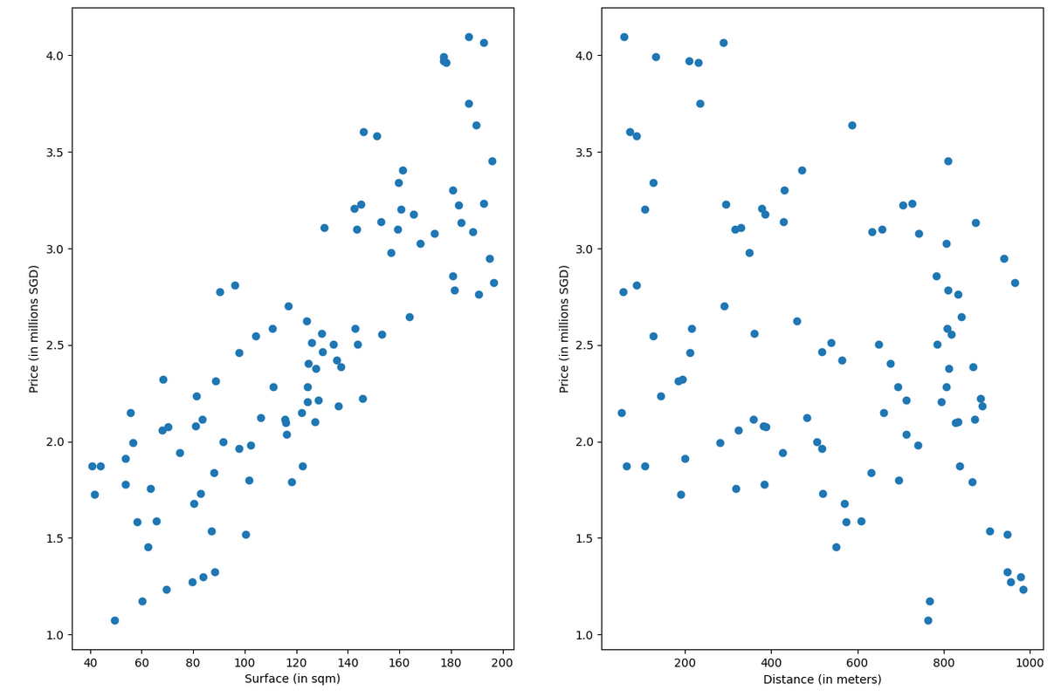

Slide 39
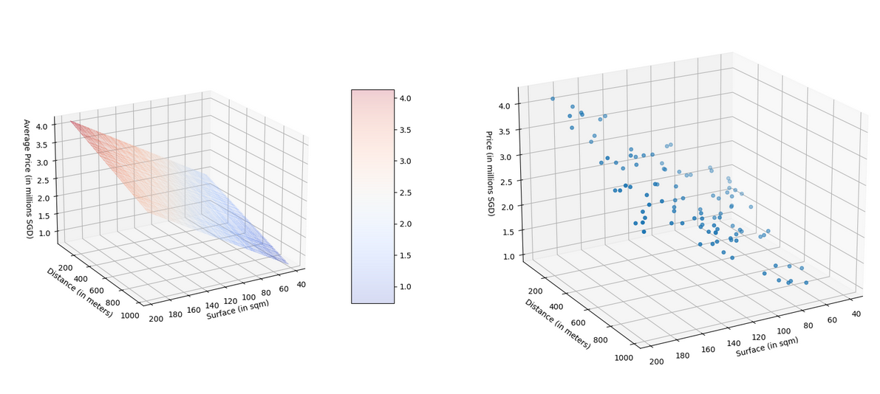
$$avgprice = 100000 + 14373× surface + \left(1000 − distance\right)× 1286$$
is actually the equation of a 2D plane in a 3D ambient space!

Slide 40
Coding a Neuron and a Neural Network
Definition (Neuron in Neural Networks):
Each artificial neuron in a neural network might for instance be represented as a linear regression (or later on, a logistic regression) model, which receives input, applies a transformation on that input, and produces an output.
And similar to the way that biological neurons are connected and communicate with each other, artificial neurons are connected to each other, in parallel and in sequence, through a network. This neural network can be thought of as pathways for information to flow.
(Later on, we will see more advanced ways to represent neurons than linear or logistic regression.)

Slide 41
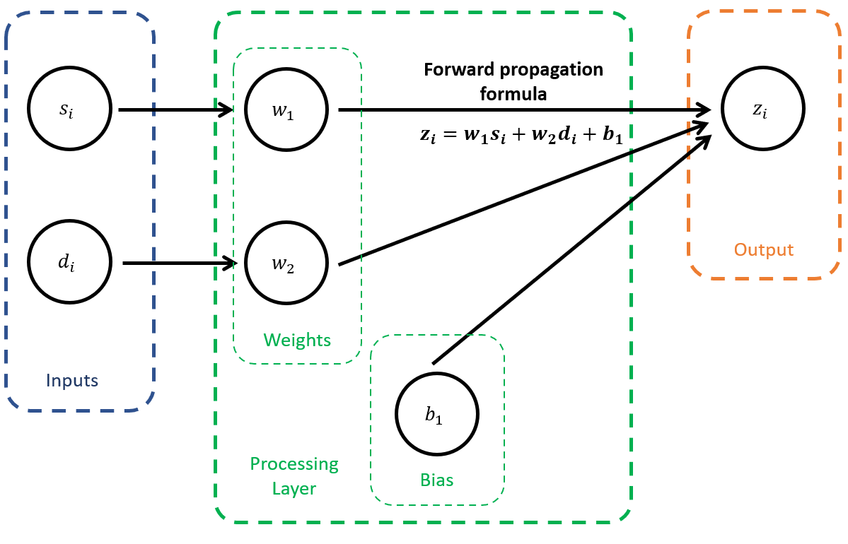
Coding our first Neuron

Slide 42
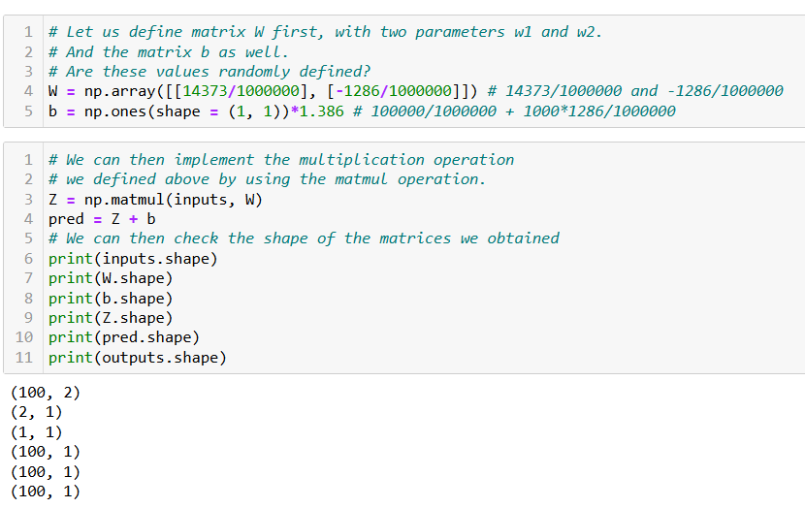

Slide 43
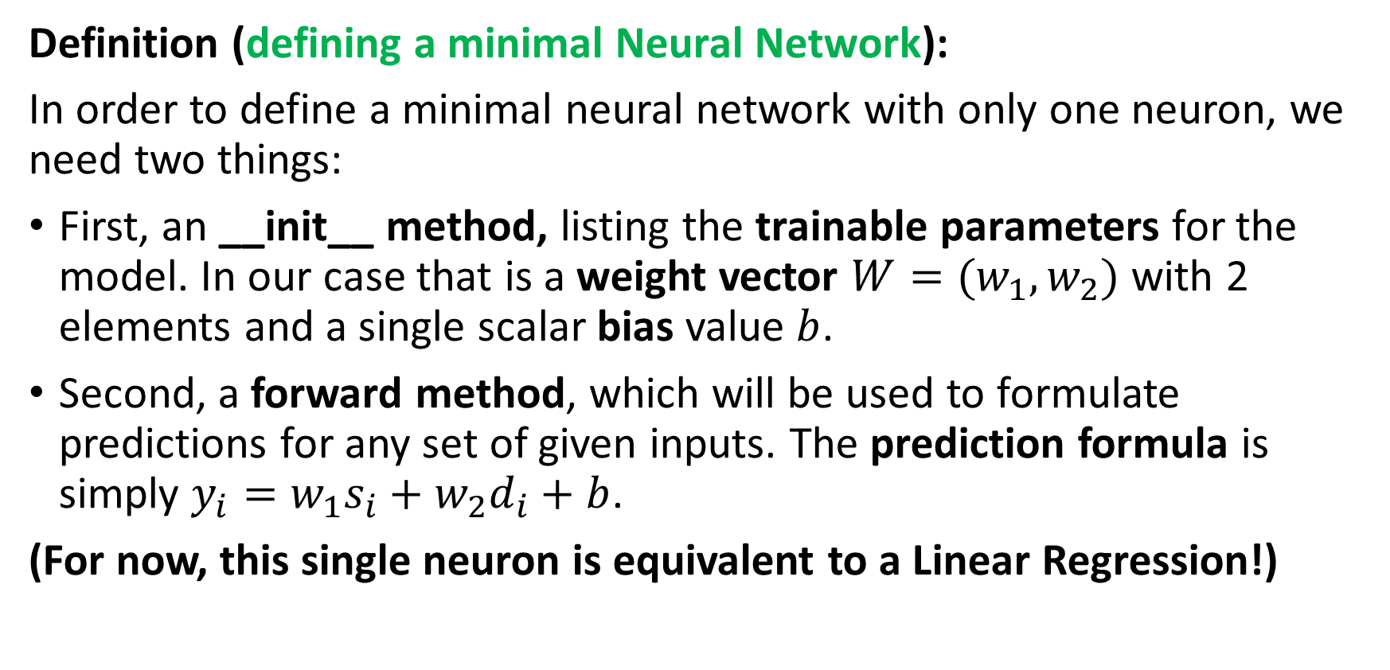
Defining a minimal Neural Network
Definition (defining a minimal Neural Network):
In order to define a minimal neural network with only one neuron, we need two things:
First, an __init__ method, listing the trainable parameters for the model. In our case that is a weight vector $W=(w_{1}, w_{2})$ with 2 elements and a single scalar bias value $b$.
Second, a forward method, which will be used to formulate predictions for any set of given inputs. The prediction formula is simply $y_{i}=w_{1}s_{i}+w_{2}d_{i}+b$.
(For now, this single neuron is equivalent to a Linear Regression!)

Slide 44
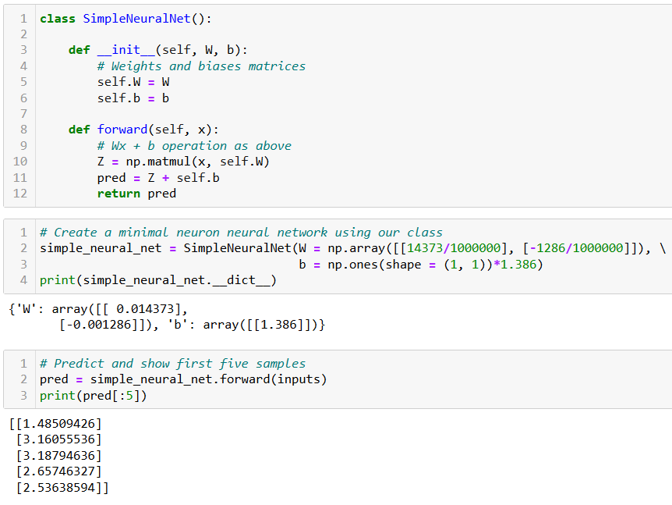
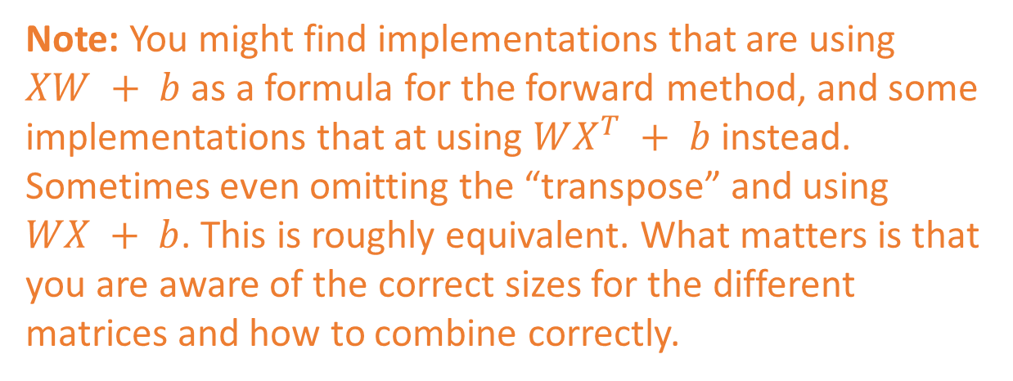
Note: You might find implementations that are using $XW + b$as a formula for the forward method, and some implementations that at using $WX^{T} + b$ instead. Sometimes even omitting the “transpose” and using $WX + b$. This is roughly equivalent. What matters is that you are aware of the correct sizes for the different matrices and how to combine correctly.

Slide 45
Adding a loss
This takes care of the first three elements of a machine learning problem (task, dataset, model).
The fourth element we need to define is a loss function.
As this is a regression task, we can reuse the MSE loss and add this MSE loss function as a method to our class.
For convenience, we will compute the MSE loss in in matrix form.
We will also reuse the forward() method we just coded to make predictions and then compared said predictions with the expected outputs from our dataset.

Slide 46

Adding a loss

Slide 47


Stacking multiple neurons in parallel
Technically, our Neural Network could operate with any number of inputs $N_{x}$ and any number of outputs $N_{y}$.
We would simply need to adjust the sizes of the matrices of parameters:
$W$ as a $N_{x}×N_{y}$ matrix,
B as a $N_{y}$ vector.
Note: This would be equivalent to having $N_{y}$neurons, each receiving $N_{x}$inputs, and each producing one output to be assembled as the $Z$ vector.

Slide 48

Scaling up with more layers
Definition (Shallow Neural Network):
Following the logic of our SimpleNeuralNet, we could implement a Shallow Neural Network.
We have just seen that it is possible to stack multiple neurons in parallel, by changing the sizes if the $W$ and $b$ parameters in a layer of neurons. We now propose to stack layers of neurons, in sequence.
Our Shallow Neural Network will now include two processing layers of neurons in a row, instead of just one, and each layer will be implementing its own $WX + b$operation of some sort.

Slide 49

Scaling up with more layers

Slide 50

Scaling up with more layers
The first layer, will receive inputs with dimensionality $n_{x}$and produce outputs with dimensionality $n_{h}$.
The matrix $W$ for this layer will therefore be of size $n_{x}× n_{h}$, and the matrix $b$ will be a simple 1D vector with size $n_{h}$.

Slide 51

Scaling up with more layers
The second layer, also called hidden layer, will receive the outputs from the previous layer with dimensionality$n_{h}$, use them as inputs and will produce outputs matching the dimensionality of the outputs in our dataset, $n_{y}$.
The matrix $W$ for this layer will be 2D $n_{h}× n_{y}$, and $b$ will be 1D $n_{y}$.

Slide 52


Our NN class
Small changes:
Weights and biases are now randomly generated, instead of being passed to the init method.
We pass the expected sizes $n_{x}, n_{h}, n_{y}$ instead.
And initialize parameters matrices, with correct sizes, as normal random with zero mean and variance 0.1.

Slide 53



Initialize model
Forward to predict
Compute loss to evaluate model (it is bad, because trainable parameters have random values!)

Slide 54

The need for a training procedure
At the moment, we have coded a model that can initialize trainable parameters randomly, formulate predictions and evaluate its own performance.
It is great, but the current models are garbage in terms of loss values. We can only try a few different initialization and pray the RNG gods to give us trainable parameters with a good loss.
We need a training procedure!
What could it be…?

Slide 55

The backpropagation mechanism
Definition (Backpropagation):
Backpropagation is an algorithm used to train neural networks.
It is a type of gradient descent (what a surprise!) algorithm that allows the network to learn by adjusting the weights of the connections between the neurons in the network.
Introduced by Hinton and Rumelhart [Rumelhart1986].
(Or was it? [Medium2020])

Slide 56

The backpropagation mechanism
Definition (Backpropagation):
Backpropagation is an algorithm used to train neural networks.
It is a type of gradient descent (what a surprise!) algorithm that allows the network to learn by adjusting the weights of the connections between the neurons in the network.
Introduced by Hinton and Rumelhart [Rumelhart1986].
(Or was it? [Medium2020])
Backpropagation will tell our model how to adjust the values of the $W$ and $b$ matrices in each layer, to improve the neural network model loss and prediction capabilities.
It will be implemented in the backward() method of our model.

Slide 57
Backpropagation is heavy to manually calculate and implement… Strongly encouraging to try and redo the math/implementation shown hereafter on your own!
That’s the best way to learn and you can always refer to these slides for answers!
After math is correct, have a look at how to implement it in a backward method (also shown in slides, but probably will be shown rapidly in class!)
Remember, you have no homework this week, so let us call that your homework!

Slide 58

Backpropagation in our model
While our Neural Network seems to be complicated in its architecture, at the end of the day, training it consists of solving a basic optimization problem.
$$W_{1}^{∗},b_{1}^{∗},W_{2}^{∗}, b_{2}^{∗}=\arg{\min_{W_{1},b_{1},W_{2},b_{2}}\left[{\frac{1}{N}\left(Y_{pred}(X,W_{1},b_{1},W_{2},b_{2})−Y \right)}^{2}\right]}$$
$$W_{1}^{∗},b_{1}^{∗},W_{2}^{∗}, b_{2}^{∗}=\arg{\min_{W_{1},b_{1},W_{2},b_{2}}\left[{\frac{1}{N}\left(W_{2}\left(W_{1}X+b_{1}\right)+b_{2}−Y \right)}^{2}\right]}$$
With $N$ being the number of samples in the dataset. We will use gradient descent, like we did for the Linear Regression, except that this time we have 4 parameters being matrices and a loss function that is a bit more complex.

Slide 59

Before we continue
Before we continue, a quick note about square matrices.
$$W_{1}^{∗},b_{1}^{∗},W_{2}^{∗}, b_{2}^{∗}=\arg{\min_{W_{1},b_{1},W_{2},b_{2}}\left[{\frac{1}{N}\left(Y_{pred}(X,W_{1},b_{1},W_{2},b_{2})−Y \right)}^{2}\right]}$$
$$W_{1}^{∗},b_{1}^{∗},W_{2}^{∗}, b_{2}^{∗}=\arg{\min_{W_{1},b_{1},W_{2},b_{2}}\left[{\frac{1}{N}\left(W_{2}\left(W_{1}X+b_{1}\right)+b_{2}−Y \right)}^{2}\right]}$$
Note: The notation ${\left(A\right)}^{2}$ is somewhat abusive when A is a matrix, the correct way would be to write $A.A^{T}$.
But in the formula above, that would lead to a very large formula (too large for slides!)

Slide 60

Chain rule, to the rescue!
Let us denote the error term $ε$.
$$ε=Y_{pred}(X,W_{1},b_{1},W_{2},b_{2})−Y=W_{2}(W_{1}X+b_{1})+b_{2}−Y.$$
Using the chain rule, we can simply compute $\frac{∂L}{∂W_{2}}$ as
$$\frac{∂L}{∂W_{2}}=\frac{∂L}{∂Y_{pred}}\frac{∂Y_{pred}}{∂W_{2}}$$

Slide 61

Chain rule, to the rescue!
Since we have
$$\frac{∂L}{∂Y_{pred}}=\frac{2}{M}Y_{pred}\left(X,W_{1},b_{1},W_{2},b_{2}\right)−Y=\frac{2ε}{M}$$
And
$$\frac{∂Y_{pred}}{∂W_{2}}=W_{1}X+b_{1}$$
The gradient descent update rule for $W_{2}$ is then defined as:
$$W_{2}←W_{2}−\frac{2εα}{M}(W_{1}X+b_{1})$$

Slide 62

Chain rule, to the rescue!
We have just computed the formula for the gradient descent update rule for $W_{2}$, which was defined as:
$$W_{2}←W_{2}−\frac{2εα}{N}(W_{1}X+b_{1})$$
Similarly, we can define the gradient descent update rule for $b_{2}$ as:
$$b_{2}←b_{2}−\frac{2εα}{N}$$

Slide 63

Chain rule, to the rescue!
Similarly, we have:
$$\frac{∂L}{∂W_{1}}=\frac{∂L}{∂Y_{pred}}\frac{∂Y_{pred}}{∂W_{1}}=\left(\frac{2ε}{M}\right)\left(W_{2}X\right)$$
$$And \frac{∂L}{∂b_{1}}=\frac{∂L}{∂Y_{pred}}\frac{∂Y_{pred}}{∂b_{1}}=\left(\frac{2ε}{M}\right)(W_{2})$$
And therefore, we have:
$$W_{1}←W_{1}−\frac{2εα}{N}W_{2}X$$
$$b_{1}←b_{1}−\frac{2εα}{N}W_{2}$$

Slide 64

Now that we have all update rules…
We have figured the four update rules to use for backpropagation…
$$W_{2}←W_{2}−\frac{2εα}{N}\left(W_{1}X+b_{1}\right)$$
$$b_{2}←b_{2}−\frac{2εα}{N}$$
$$W_{1}←W_{1}−\frac{2εα}{N}W_{2}X$$
$$b_{1}←b_{1}−\frac{2εα}{N}W_{2}$$
Now it is about implementing two additional methods for our Neural Network class:
Backward method: It performs the calculation of gradients, in matrix form, and parameters adjustments using the gradient descent update rules shown on the left.

Slide 65
Now that we have all update rules…
We have figured the four update rules to use for backpropagation…
$$W_{2}←W_{2}−\frac{2εα}{N}\left(W_{1}X+b_{1}\right)$$
$$b_{2}←b_{2}−\frac{2εα}{N}$$
$$W_{1}←W_{1}−\frac{2εα}{N}W_{2}X$$
$$b_{1}←b_{1}−\frac{2εα}{N}W_{2}$$
Now it is about implementing two additional methods for our Neural Network class:
Trainer method: It repeats the backward method, reusing the gradient descent for-loop function from earlier in Notebook 2, until a maximal number of iterations is reached or convergence is seen.

Slide 66
Training procedure, in short.
Forward pass on dataset samples. Compute errors and loss function.
Use new loss value to compute gradients. Adjust parameters with backprop.
Repeat until convergence or max number of iterations, as in GD earlier.

Slide 67


Backpropagation in our model
Update rules for $W_{2}$and $b_{2}$
$$ε=W_{2}(W_{1}X+b_{1})+b_{2}−Y$$
$$W_{2}←W_{2}−\frac{2εα}{N}(W_{1}X+b_{1})$$
$$b_{2}←b_{2}−\frac{2εα}{N}$$

Slide 68


Backpropagation in our model
Update rules for $W_{1}$and $b_{1}$
$$W_{1}←W_{1}−\frac{2εα}{N}W_{2}X$$
$$b_{1}←b_{1}−\frac{2εα}{N}W_{2}$$

Slide 69


Backpropagation in our model
Effect of the backpropagation
Every time we call the backward() method, our model will update its parameters $W_{1}$, $W_{2}$, $b_{1}$ and $b_{2}$.
After every call of backward(), our model seems to become better at the task in question, shown by improvements in loss values.
This can be seen by looking at the loss values decreasing after each iteration of the backward() method.

Slide 70
Training procedure, in short (reminder).
Forward pass on dataset samples. Compute errors and loss function.
Use new loss value to compute gradients. Adjust parameters with backprop.
Repeat until convergence or max number of iterations, as in GD earlier.
→ Done.
→ Done.
Next!

Slide 71


Trainer function for our model
Train function implementation
Iterate the backward() method for a number of iterations $N_{max}$.
Display new loss values and append them in a list for display.
Also implemented an early stopping, which will break for loop if little to no change in parameters during an iteration of backward().
Similar to GD in Notebook 2!

Slide 72

Trainer function for our model
Successful training as losses are decreasing over iterations?

Slide 73

Trainer function for our model
The curve below is called a training curve, it is useful to show how the training went (make an extra viz method to be used after training?).
Loss has decreased and converged.
Confirmed training?

Slide 74

Finally, we will make the trainer function and the performance curves function into methods for our class.

Slide 75
Backpropagation is heavy to manually calculate and implement… Strongly encouraging to try and redo the math/implementation shown on your own!
That’s the best way to learn and you can always refer to these slides for answers!
After math is correct, have a look at how to implement it in a backward method (also shown in slides, but probably will be shown rapidly in class!)
Remember, you have no homework this week, so let us call that your homework!

Slide 76
Conclusion (Week 1)
Reminders of Machine Learning
Linear
Using a normal equation to train a linear regression
Gradient descent as a training procedure for linear regression
Polynomial Regression
Regularization in Ridge/Lasso Regression
Train-test split
Overfitting and underfitting
Generalization
Sigmoid and Logistic functions
From linear regression to logistic regression
Using logistic regression for binary classification

Slide 77
Conclusion (Week 1)
Implementing a shallow neural network in Numpy
Forward propagation method, to formulate predictions
The backpropagation mechanism, as the gradient descent on Neural Network
Backward method for training and trainer functions to iterate backward iterations
Performance/training curves
Next week?
Initializations to break symmetries
Exploding and vanishing gradients
Activation functions and non-linearities in Neural Networks
Advanced optimizers
Validation sets, early stopping, saver and loader functions

Slide 78
Learn more about these topics
Out of class, supporting papers, for those of you who are curious.
[Géron2019] A. Géron , “How Neural Networks Work”, 2019.
[Yamins2016] Yamins et al., “Deep neural networks are robust computational models of the human visual system”, 2016.
[Kriegeskorte2013] Kriegeskorte and Kievit, “Neural Network Models of the Human Brain”, 2013.
[Rumelhart1986] D.E. Rumelhart, G. Hinton, Williams, “Learning representations by back-propagating errors“, 1986. https://www.nature.com/articles/323533a0

Slide 79
Learn more about these topics
Keep track of important names and follow their social media (Follow them on Scholar, Twitter, or whatever works for you!)
Geoffrey Hinton: Emeritus Professor at University of Toronto, one of the three Godfathers of Deep Learning and 2018 Turing Award winner (highest distinction in Computer Science), Nobel Prize Physics 2025. Formerly, Google. https://www.cs.toronto.edu/~hinton/ https://scholar.google.co.uk/citations?user=JicYPdAAAAAJ&hl=en
David Rumelhart: Former professor at University of California, credited for inventing backpropagation along with Hinton. Passed away in 2011. https://www.nytimes.com/2011/03/19/health/19rumelhart.html

Slide 80



Twitter, the theater for AI/DL drama and big AI announcements
NYU Professor
Announcing Dall-E 2 and its future release
NYU Professor, former Chief of AI at Meta (Facebook), and one of the three godfathers of AI.

Slide 81
Learn more about these topics
Some extra (easy) reading and videos for those of you who are curious.
[Quanta2021] “Artificial Neural Nets Finally Yield Clues to How Brains Learn“, 2021. https://www.quantamagazine.org/artificial-neural-nets-finally-yield-clues-to-how-brains-learn-20210218/
[MITNews2022] “Study urges caution when comparing neural networks to the brain”, 2022. https://news.mit.edu/2022/neural-networks-brain-function-1102
[Medium2020] “Who Invented Backpropagation? Hinton Says He Didn’t, but His Work Made It Popular“, 2020. https://medium.com/syncedreview/who-invented-backpropagation-hinton-says-he-didnt-but-his-work-made-it-popular-e0854504d6d1/

